Slide 1

Intro to resilience modelling, simulation, and visualization in Python with fmdtools
Author: Daniel Hulse
Version 1.3

Slide 2
Overview/Prerequisites
Overview of fmdtools
Purpose
Code structures
Methods
Syntax
Coding Activity
Example model
Workbook
Model Instantiation
Simulation
Visualization/Analysis
Download Slides:
/docs/Intro to Fmdtools
Right click “Save link as…”
You need a Python distribution!
(preferable Anaconda)
https://www.anaconda.com/products/individual

Slide 3
Why model system resilience?
We want to know how the system will respond to hazardous events, to:
Reduce unforeseen maintenance/repairs
Ensure system safety
Check that system behavior will be robust to unforeseen events
In a hazardous scenario:
Will the system fail to a safe condition?
Will it recover?
Or, will it wreak havoc on itself and the environment?

Slide 4
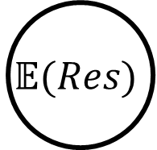
What is resilience?
Prevention
Recovery
Nominal Scenario
$$\text{𝔼}(Res)$$
Nominal Performance
Hazard
Expected
Resilience:
Resilience over a set of hazardous scenarios
Recovery
Resilience
No Recovery
Faulty Performance
Fault Time
Yodo, N., & Wang, P. (2016).

Slide 5
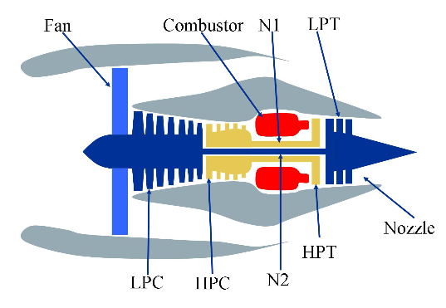
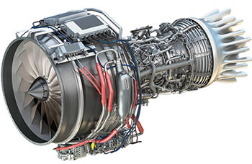
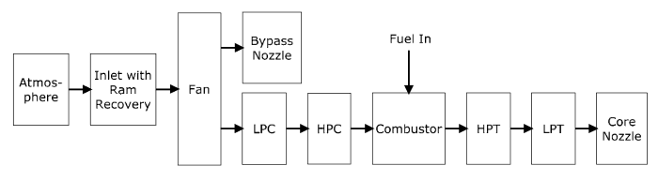
Why use resilience in design?
Concept Design
Embodiment Design
Implementation
Reactive
Design
Choose concept
Design system
Retrofit for resilience
?
?
?
?
So we can make the system resilient-by-design
Proactive
Design
Establish resilience approach
Integrate resilient features in design
Verify resilient function
?
?
✔
✔
S3
?
?
?
✔
S2
✔
S1
Image 1 & 2 Credit: User’s Guide for the Commercial Modular Aero-Propulsion System Simulation (C-MAPSS)
Image 3 Credit: https://en.wikipedia.org/wiki/File:General_Electric_Passport.jpg

Slide 6
Why fmdtools? Why not an existing tool?
Uncertainty Quantification tools: (e.g. OpenCossan)
Doesn’t incorporate fault modelling/propagation/visualization aspects
MATLAB/modelica/etc. Fault Simulation tools
Rely on pre-existing model/software stack
Useful, but often difficult to hack/extend
Safety Assessment tools: (e.g. Alyrica, Hip-Hops)
Focused on quantifying safety, not necessarily resilience
(though they are related)
Different model formalisms!

Slide 7
Why fmdtools?
Expressive:
Undirected graph propagation
faults from any component can propagate to any other connected component
General model representation—not a strict formalism
Behavioral (equations), fault logic (if-else statements), etc.
Dynamic simulation needed to quantify resilience
Research-oriented:
Written in/relies on the Python stack
Open source/free software
Enables design:
Models can be parameterized an optimized!
Provides tools to visualize and quantify simulation results

Slide 8
Why not fmdtools?
Limitations:
Doesn’t work with existing models in different software
no integration with Simulink, modelica, etc. system models
It’s research code
Not yet fully tested outside of known use-cases
Ongoing development may create problems for existing models

Slide 9
What is fmdtools?
Construct Model
Function classes
Model class
Sample approach
Simulate Faults
Over each fault
Over each time
Record result histories
Analyze Resilience
Expected costs
Behavior over time
Plots/animations
Network Structure Model
Increasing Model Detail/Fidelity
Static Propagation Model
Dynamic Behavioral Model
Hierarchical Model
Stochastic Model
A Resilience-based Design Environment

Slide 10
Repository
https://github.com/nasa/fmdtools
/fmdtools - toolkit modules
/example_XXX – example models
example_pump - Simple model and tutorial/demonstration notebooks
example_multirotor - Example of several model types from "fmdtools: A Fault Propagation Toolkit for Resilience Assessment in Early Design“ as well as an example of combined architecture, flight plan, and fault policy optimization
example_eps - Example of a static propagation model
example_tank - Example of a human error model implemented with components, as well as an example of combined architecture/fault policy optimization
example_rover - Example of human modelling constructs (PSFs, degradation models) as well as synthetic mode generation, policy optimization, and optimization for mode generation
/docs - additional documentation
/tests - automated software tests
Toolkit modules also available from PyPl (e.g. pip install fmdtools)

Slide 11
Activity: Download and Install fmdtools
Make sure Python environment is installed
e.g. https://www.anaconda.com/products/individual
Install fmdtools from PyPl:
pip install fmdtools
Download workbook files from Github repository
https://github.com/nasa/fmdtools
Navigate to /example_pump
Right Click Tutorial_unfilled.ipynb and click “Save Link As” to download
Right Click ex_pump.py and click “Save Link As” to download to your computer
Open the notebook and model!

Slide 12
Structure: /fmdtools
Design
Simulation
Analysis
modeldef.py
Model class: representation of model functions, flows, behaviors, faults, etc.
Function class
Flow class, …
SampleApproach class: defines set of fault scenarios to represent the statistical expectation of resilience
NominalApproach class: defines set of nominal scenarios for simulating design/operational envelope
/faultsim
/resultdisp
networks.py
Quantification and visualization of metrics using a network model representation
process.py
Processing of simulation results into metrics/statistics
plot.py
Plotting of system behaviors and costs over time
propagate.py
Propagation of model behaviors in nominal and faulty scenarios
graph.py
Visualization of simulation results on the model graph
search.py
ProblemInterface and DynamicInterface class: Interfaces for optimization of model parameters/scenarios
tabulate.py
Display and export of simulation results as tables

Slide 13
A typical work-flow
Define model: System.py
Model Class:
Run parameters
Function/flow connections
Effects Classification
Function/Component Classes:
States
Behaviors
Simulate, visualize process model: Script.py or Notebook.ipynb
Model instantiation (e.g. mdl = Model())
Behavior simulation
propagate.nominal(mdl), propagate.one_fault(mdl, fault, t) …
Results processing and visualization
graph.show(mdl), plot.mdlhists(mdlhist) …
tabulate.hist(mdlhist), tabulate.simplefmea(endclasses)…
System
SampleApproach,
NominalApproach
Model, FxnBlock, Component
modeldef.py
/faultsim/propagate.py
/resultdisp/plot.py
/resultdisp /graph.py
…

Slide 14
Defining a model
What do we want out of a model?
What functions/components and how much fidelity do we need?
Network or behavioral?
Dynamic or static?
Functions or component architectures?
Behaviors or failure logic?
What can go wrong? What are the faults/events?
What model parameters do we need to assess the resilience over?
What are the possible effects and how bad are they?

Slide 15
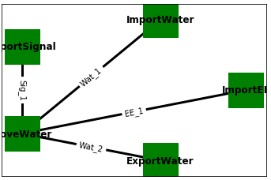
Demonstration Model - Pump
/pump example/ex_pump.py
Functions: (nodes)
Define behaviors, and faults of the of the system
e.g. ImportSignal, ImportWater, MoveWater, ExportWater, ImportEE
Flows: (edges)
Define the connections between functions of material, energy, signal, etc.
e.g. Sig_1, Wat_1, EE_1, Wat_2

Slide 16
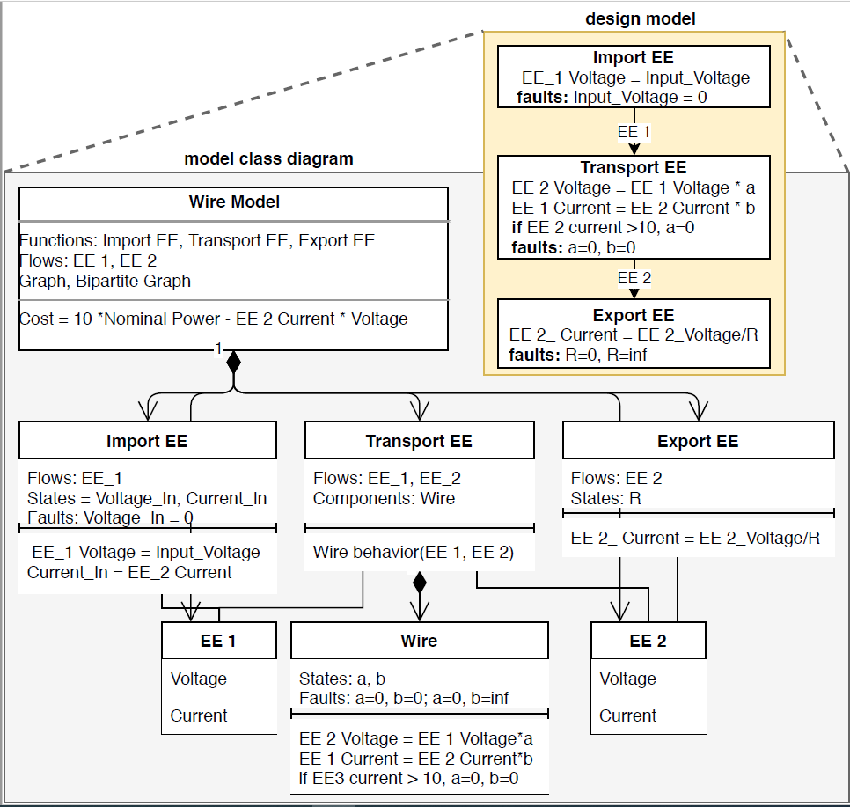
Model structure
Function Classes
Behaviors (I/O relationships)
Faults (modes, probabilities)
States (variable values)
Failure logic (fault effects)
Relationships to flows and components
Component Classes
Similar to function classes, but no access to flows outside of function
Model Class
Function/Flows
Function/flow objects
Graph of connections
Run parameters
Time, phases, units, etc
Classification Method
Method for determining fault effect costs
Flows
State Dictionary
EE = {voltage: 1.0, current:1.0}

Slide 17
Defining a model – generic code
(imports)
from fmdtools.modeldef import Model, FxnBlock
class System(Model):
def __init__(self, params={}, modelparams={}, valparams={})
super.__init__(params,modelparams,valparams)
self.add_flow(flowname, {value1:initvalue, value2: initvalue} …
self.add_fxn(functionname, [list of flows], fclass = DoSomething) …
self.build_model()
def end_condition(self, time):
(anything)
return True/False at end-state
def find_classification(self,resgraph, endfaults, endflows, scen, mdlhists):
(anything)
return {‘rate’:rate, ‘cost’:cost, ‘expected cost’=expected cost
(defining model class for system)
(model initialization method)
design params
simulation params (e.g., start/end)
value params (fxns/flows to track)
(attach params to model)
(define model flows)
(add and connect functions)
(form model graph and run order, etc.)
(define how to classify model results)

Slide 18
Defining functions – generic code
Define class for DoSomething function
Class DoSomething(FxnBlock):
def __init__(self, name, flows):
super.__init__(name, flows,{state1: initval}, …)
self.failrate = failrate
self.assoc_modes({mode1:properties}, [opermodes])
self.assoc_randstate(statename, default)
def behavior(self, time):
if self.flowname.val1 > threshold: self.add_fault(‘mode1’)
if self.has_fault(‘mode1’): self.flowname.val2 = 0
else: self.flowname.val2 = 1
def dynamic_behavior(self,time):
self.state1.inc(self.flowname.val2)
def static_behavior(self,time):
initialization method (can also be used to pass parameters)
add/associate model constructs:
flows, states, timers, components
Define fault/operational modes
Associate random states (for stochastic simulation)
generic method for all (static and dynamic) behavior
(different modes change behaviors)
method for dynamic (once per timestep) behaviors
(accumulation of a state over time)
method for static behaviors that can propagate between constructs during a single timestep

Slide 19
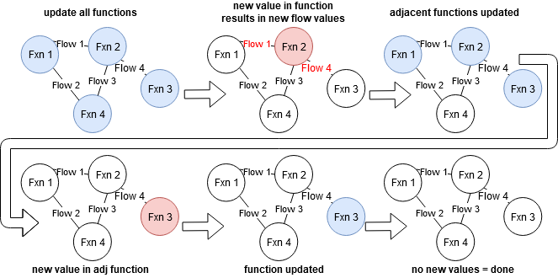
Static Fault Propagation
Behaviors defined in .behavior(), .static_behavior(), and .condfaults()
Stored in mdl.staticfxns

Slide 20
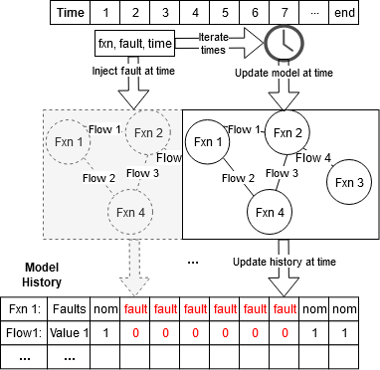
Dynamic Fault Propagation
Defined in .dynamic_behavior()
Runs once per timestep in a user-specified order.
Accessible in mdl.dynamicfxns
--------
Static/Dynamic propagation can be visualized using rd.graph.exec_order()

Slide 21
Activity: Open and instantiate pump model
Review code:
See pump code defining the Pump model class
See pump code defining MoveWater function class
Open tutorial notebook
Tutorial_unfilled.ipynb
Instantiate the model
mdl = Pump()
Explore
Try different parameters! Change things!
What does the model directory look like? dir(mdl)

Slide 22
Goal: Quantify Resilience With Simulation
Prevention
Recovery
Nominal Scenario
$$\text{𝔼}(Res)$$
Nominal Performance
Hazard
Expected
Resilience:
Resilience over a set of hazardous scenarios
Recovery
Resilience
No Recovery
Faulty Performance
Fault Time
Yodo, N., & Wang, P. (2016).

Slide 23
Simulation—things to consider
What are we trying to model:
The nominal performance of a system?
The performance of a system over a set of operational paremeters
The performance in a fault scenario?
The performance over a set of fault scenarios?
What kind of set?

Slide 24
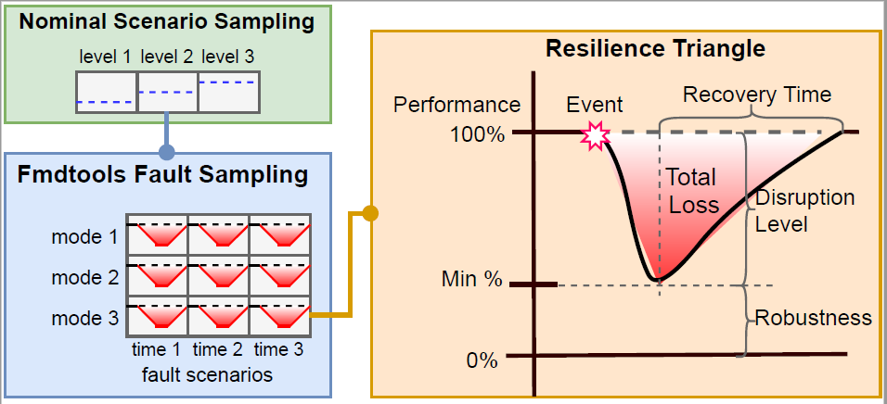
Simulation types
Nominal performance
Performance over a set of possible operational parameters
Resilience to a single fault or hazard
Resilience over a set of fault modes
Resilience to a set of fault modes over a set of operational parameters

Slide 25
Fault propagation aspects
Static/Dynamic propagation: How function states propagate to each other in a single time-step and multiple time-steps
Undirected graph representation—states can effect all other connected states, and vice versa, in any order
Stochastic Propagation: Whether and how stochastic states are instantiated over time
e.g. do we run with the “default” values of parameters, or do we sample from a random number generator?
Breadth of Scenarios: How hazards are represented as discrete scenarios to simulate
What set of joint faults do we use? How many times are sampled?
Operational scenarios and Joint operational/fault scenarios

Slide 26
Behavioral Simulation Methods
propagate.nominal(mdl)
Simulates system once with no fault—good for model setup
propagate.one_fault(mdl, function, fault, time=faulttime), .propagate.mult_fault(mdl, faultseq, disturbances)
Simulates system once with and without a fault
Good for verifying/visualizing model behavior under a given fault
propagate.single_faults(mdl)
Simulates the list of single fault modes
Only use for static (single time-step) models & to gauge fault severity
propagate.approach(mdl, app)
Simulates a set of fault modes over a set of times
Useful for expected resilience quantification
app defined in SampleApproach class
propagate.nominal_approach(mdl, nomapp), propagate.nested_approach(mdl,nomapp, **app_args)
Used for sampling the model over a range of parameters defined in a NominalApproach in nominal (nominal_approach) and faulty (nested_approach) scenarios.

Slide 27
Simulation types
Nominal performance
propagate.nominal()
Performance over a set of possible operational parameters
propagate.
nominal_approach()
Resilience to a single fault or hazard
propagate.one_fault()
propagate.mult_fault()
Resilience over a set of fault modes
propagate.approach()
Resilience to a set of fault modes over a set of operational parameters
propagate.nested_approach()

Slide 28
Definition of a fault sampling approach
app = SampleApproach(mdl,
faults = ‘all’/[list of faults]
phases = ‘all’/{fxn:phase:[s,e]}
modephases = {fxn:mode:{phases}}
jointfaults = {‘faults’:#,
‘jointfuncs’:True/False
‘pcond’: 0.##}
defaultsamp: = {‘samp’: ‘quad’/’fullint’/’evenspacing’…
‘numpts’: #
‘quad’: quadrature}
sampparams = {(fault, mode): sampparam}
(faults to include in the list)
(phases of each function to include (if model has phases))
(how function modes correlate to phases)
(Number of joint-fault modes to simulate (e.g. None, 2,3,..))
(Whether function modes are mutually exclusive)
(Conditional probability for joint faults (ind. by default))
(how to represent phases)
(Number of samples to take in each phase)
(If a quadrature is used, the quadpy object)
(If a different approach is to be used for each fault, sampparam follows the defaultsamp structure)

Slide 29
Definition of a nominal sampling approach
nomapp = NominalApproach()
nomapp.add_seed_replicates(raingeid, seeds)
nomapp.add_param_replicates(paramfunc, rangeid, replicates)
nomapp.add_param_ranges(paramfunc, rangeid, *args, **kwargs
nomapp.add_rand_params(paramfunc, rangid, *fixedargs, **randvars)
Instantiate approach
Construct approach as a set of random seeds to instantiate in the model
Construct approach as the output of parameters in a function over x replicates
Construct approach as the output of a parameter function a range of arguments *args, and **kwargs
which may either be fixed or varied as a tuple defining the range (start, end, step)
Construct approach as the output of a parameter function a range fixed arguments *fixedargs
and stochastic variables generated in **kwargs as (randfunc, funcparam1, funcparam2)

Slide 30
Activity: Propagate faults in the model
Run fault propagation methods:
Nominal
Fault(s)
Approach
What do the results look like?
endresults, resultshist, etc
Explore:
What happens when you change SampleApproach parameters?
What happens when you change model parameters?
How do these methods compare in terms of computational time?

Slide 31
Visualization, Quantification, Processing
Looking at a model
Looking at modelled quantities
Quantifying resilience
Saving/exporting results, etc

Slide 32



/resultdisp
process.py
Processing of simulation results into metrics/statistics
-hists(mdlhists)/hist(mdlhist): processes result history for fmea/visualization
-heatmaps(reshist), etc: creates heatmap of respective quantities over time/runs
-totalcost(endclasses): calculates total expected cost
-end/overall_diff(endclasses):
Difference between nominal and faulty scenarios
-percent/average/rate/…
Various statistics for endclasses
plot.py
Behavioral/Statistical Plotting
-mdlhists(mdlhist):
Plots behavior of given states over time in a set of scenarios
-metric_dist()/_from():
Histograms of modelled metrics
-samplecost(app, endclasses):
Cost and rates of a set of faults
-costovertime(endclasses,app):
Cost of fault modes over time
-phases(mdlphases)
Function modes over time.
-nominal_vals_1d/2d/3d():
Simulation metric(s) in terms of input parameters
-nom/res_factor_comparison()
Comparison of simulation statistics over given factors
graph.py
Visualization of simulation results on the model graph
-set_pos(graph):
Manually positions of functions/flows in graph
-show(mdl/graph):
Show graph at end-state
-exec_order(mdl/graph)
Show dynamic/static order
-history(graphhist):
Shows set of graphs over history
-result(s)_from(mdl, reshist, t)
Shows model state at a particular time(s)
-animation_from(mdl, reshist,t)
Animates model states over given times
tabulate.py
Display and export of simulation results as tables
-hist(mdlhist): Gives table of the history of model states.
-deghist(mdlhist, withstats): Gives table of all degraded functions and flows over time
-heatmaps(heatmap): Displays heatmap dictionary
-simple/phase/sum/fullfmea():
FMEA-like assessment with faults, probabilities, and costs.
-nominal/nested_stats():
Table of simulation statistics
-nom/res_factor_comparison()
Table of simulation statistics over given factors
plot.py
Behavioral/Statistical Plotting
-mdlhists(mdlhist):
Plots behavior of given states over time in a set of scenarios
-samplecost(app, endclasses):
Cost and rates of a set of faults
-costovertime(endclasses,app):
Cost of fault modes over time
-phases(mdlphases)
Function modes over time.
-nominal_vals_1d/2d/3d():
Simulation metric(s) in terms of input parameters
-nom/res_factor_comparison()
Comparison of simulation statistics over given factors
Netgraph

Slide 33
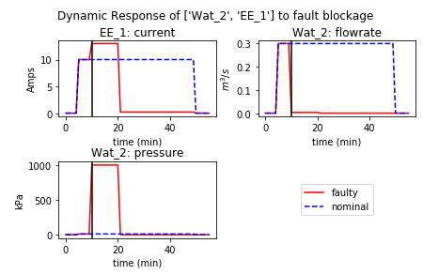
plot.py
plot.py
Behavioral/Statistical Plotting
-mdlhists(mdlhist):
Plots behavior of given states over time in a set of scenarios
-metric_dist()/_from():
Histograms of modelled metrics
-samplecost(app, endclasses):
Cost and rates of a set of faults
-costovertime(endclasses,app):
Cost of fault modes over time
-phases(mdlphases)
Function modes over time.
-nominal_vals_1d/2d/3d():
Simulation metric(s) in terms of input parameters
-nom/res_factor_comparison()
Comparison of simulation statistics over given factors
Example Syntax:
fig, ax = rd.plot.mdlhists(mdlhist, title=“Response to faultname”,
time_slice=faulttime,
fxnflowvals={‘Flow1':[‘val1', ‘val2'],’flow2’:’val1’},
cols=2, timelabel="time (min)")

Slide 34
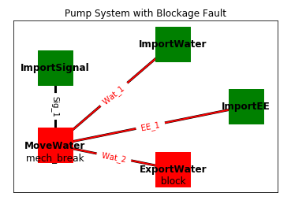
graph.py
plot.py
Behavioral/Statistical Plotting
-mdlhist/s/vals(mdlhist):
Plots behavior of given states over time in a set of scenarios
-samplemetric(app, endclasses):
Metric and rates of a set of faults
-metricovertime(endclasses,app):
Metric of fault modes over time
-phases(mdlphases)
Function modes over time.
-nominal_vals_1d/2d/3d():
Simulation metric(s) in terms of input parameters
-nom/res_factor_comparison()
Comparison of simulation statistics over given factors
Example Syntaxes:
fig, ax = rd.graph.show(mdl.graph)
fig, ax = rd.graph.show(resgraph)
fig, ax = rd.graph.result_from(mdl, reshist, time,
gtype = ‘normal’/'bipartite’,
scale=2, pos=pos)

Slide 35
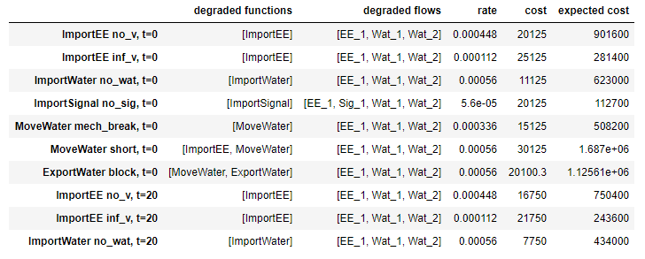
tabulate.py
tabulate.py
Display and export of simulation results as tables
-hist(mdlhist): Gives table of the history of model states.
-deghist(mdlhist, withstats): Gives table of all degraded functions and flows over time
-heatmaps(heatmap): Displays heatmap dictionary
-fmea():
FMEA-like assessment with faults, probabilities, and costs.
-nominal/nested_stats():
Table of simulation statistics
-nom/res_factor_comparison()
Table of simulation statistics over given factors
Example Syntaxes:
reshists, diffs, summaries = rd.process.hists(mdlhists)
fullfmea = rd.tabulate.fullfmea(endclasses, summaries)
phasefmea = rd.tabulate.phasefmea(endclasses, app)

Slide 36
Activity: Visualize the results
Visualize the results
Show model graph
Show nominal performances
Show performances in a nominal scenario
Make a scenario-based fmea
Explore
How can you show only the parameters you want? Or change the formatting?
What does the behavior under other faults look like?
What other analyses can you perform with these results?

Slide 37
Further Reading
Modelling/Simulation Basics
Scenario Sampling
Advanced/Specialized Model Setup
1. Model Definition
/docs/Model Structure Visualization Tutorial.ipynb
5. Fault Sampling Approaches
/docs/Approach Use-Cases.ipynb
9. Advanced Scenario Sampling
/example_rover/fault_sampling/Rover Mode Notebook.ipynb
/example_pump/AST_Sampling.ipynb
/example_rover/optimization/Search Comparison.ipynb
6. Simulation Parallelism
/example_pump/Parallelism Tutorial.ipynb
2. Model Simulation
/example_multirotor/Demonstration.ipynb
10. Optimization
/example_rover/optimization/Rover Response Optimization.ipynb
/example_multirotor/Multirotor Optimization.ipynb
/example_pump/Optimization.ipynb
/example_tank/Tank Optimization.ipynb
7. Nominal/Nested Approaches
/docs/Nominal Approach Use-Cases.ipynb
/example_rover/degradation_modelling/Degradation Modelling Notebook.ipynb
3. Plotting/Visualization
/example_pump/Pump Example Notebook.ipynb
4. Human Modelling
/example_rover/Rover Setup Notebook.ipynb
/example_rover/HFAC Analyses.ipynb
/example_rover/IDETC_Human_Paper_Analysis.ipynb
8. Stochastic Simulation
/example_pump/Stochastic Modelling.ipynb
11. Further Examples
/example_tank/Tank Analysis.ipynb
/example_eps/EPS Example Notebook.ipynb
D. Hulse, H. Walsh, A. Dong, C. Hoyle, I.Y. Tumer, C. Kulkarni, K. Goebel, “fmdtools: A Fault Propagation Toolkit for Resilience Assessment in Early Design“ IJPHM. Submitted
D. Hulse, C. Hoyle, I.Y. Tumer, K. Goebel, C. Kulkarni, “Temporal Fault Injection Considerations in Resilience Quantification.” ASME IDETC/CIE 2020, Design Automation Conference. IDETC2020-19287.
Hulse, D., & Irshad, L. (2022). Synthetic fault mode generation for resilience analysis and failure mechanism discovery. Journal of Mechanical Design, 145(3), 031707.
Hulse, D., & Irshad, L. (2022, September). Using Degradation Modeling to Identify Fragile Operational Conditions in Human-and Component-driven Resilience Assessment. In 2022 IEEE/AIAA 41st Digital Avionics Systems Conference (DASC) (pp. 1-10). IEEE.
Irshad, L., & Hulse, D. (2022, August). Resilience Modeling in Complex Engineered Systems With Human-Machine Interactions. In International Design Engineering Technical Conferences and Computers and Information in Engineering Conference (Vol. 86212, p. V002T02A024). American Society of Mechanical Engineers.

